Slide 1
Lions Rheumatism and Arthritis Medical Research Foundation Australia

Slide 2
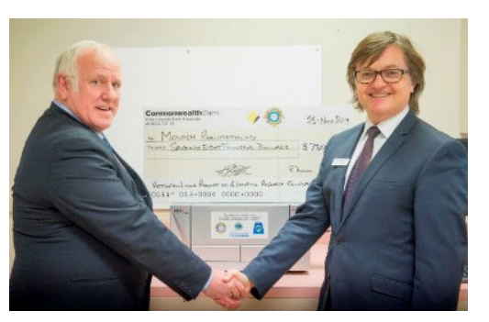
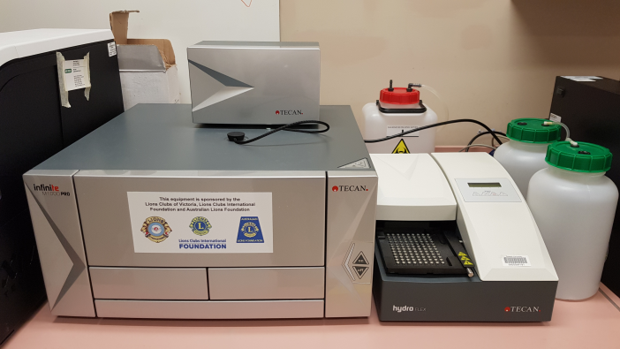
Lions Rheumatism and Arthritis Medical Research Foundation Australia
A Project of the Lions Clubs, Australia
The Lions Rheumatism and Arthritis Medical Research Foundation Australia was established by the Lions Clubs of Elwood to support the development of Rheumatism and Arthritis Research for the benefit of the population within the five Lions Club Districts encompassing Victoria and Southern New South Wales.
This is a Lions International District 201V1-4 project and is currently run by elected members from the following Lions Clubs; Northcote, Heidelberg-Warringal and Essendon, for the Victorian Lions Districts.
The primary role of the Foundation is to create a Capital Fund to support research programmes through liaison with Lions Clubs, Charitable Trusts and Corporations.
The latest donation from Lions Clubs of $78000.00 plus funds from Monash was made to purchase a Tecan Microplate Reader.
Eric Gittins and SCS Head Prof Eric Morand with the M1000 Pro multifunction plate reader and
Tecan HydoFlex plate washer
Tecan HydoFlex plate washer

Slide 3
Aims
To maintain a fund so as to support a Research Fellow.
The fund’s target is $2 million.
Current balance in December 2019 is $350k.

Slide 4
About Us
Current Trustees are all elected from Lions Clubs International District 201V1-4 on a rotational basis:
Chairperson: Past District Governor Pauline Harris
Secretary/Treasurer: Past District Governor Eric Gittins
Committee Members: Lion Marie Cavern Lion Winston van Haltren Lion Rodney Hales Lion Selva Selvendra
Donations have amounted to almost $400,000.00 and recently a donation of $78,000.00 was made to purchase a TECAN Microplate Reader, and more recently a Plate Washer for $11000.00
Funds have been sponsored by donations to this Foundation, from the Australian Lions Foundation, Lions Clubs International Foundation, District Lions Clubs and Gilham Financial Management.

Slide 5
History
The Foundation was formed by the Lions Club of Elwood and was a project of District 201V1.
The first trustees in 1980 were Lion Ian Collis (Elwood), Past District Governor Neil Armstrong, Lions Henry Bell, David Hatfield, Piloo Rustromjee, and Roger Newton. Elwood had two trustees up until about 2000.
Lion Terry Collison joined the Trustees in the early 90s, was Vice Chairman and took over from Neil as Chairman in the middle 90s until 2000.
Main fundraising in the beginning was donations from Clubs in District 201V1. From 1994 to 1997, the Foundation was the main beneficiary for the "Gown of the Year” (run by the fashion industry).
The Foundation funded research at the Monash Medical Centre from the beginning and was funding at $10,000 per year ($2500 each quarter) from interest earned.
Current donations are about $5000 per half year.

Slide 7
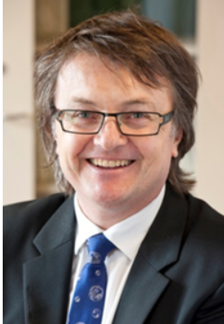
Professor Eric Morand is a specialist rheumatologist, and Head of the Southern Health/Monash Medical Centre Rheumatology Unit.
He specialises in the clinical care of complex rheumatic diseases, rheumatoid arthritis, and systemic lupus erythematosus. (SLE)
He is founder of the Monash Lupus Clinic, Australia's largest Lupus-focussed research-grounded clinic for patients with SLE.

Slide 8
What is rheumatoid arthritis?
Rheumatoid arthritis (RA) is an autoimmune disease, in many ways similar to lupus, that causes pain and swelling of the joints. The normal role of your body's immune system is to fight off infections to keep you healthy. In an autoimmune disease, your immune system starts attacking your own healthy tissues. In RA, the immune system targets the lining of the joints, causing inflammation and joint damage. RA usually affects smaller joints, such as the joints in the hands and feet. However larger joints such as the hips and knees can also be affected.
Who's at risk?
Despite widely held views, developing rheumatoid arthritis is not a normal part of ageing. It's a condition seen in people of all ages, including children and young people, and people from all backgrounds and lifestyles. The causes of RA are unknown, however it is more common in people who smoke or those with a family history of rheumatoid arthritis.
Recent surveys (National Statistics and also University of Queensland) report that 1 in 5 or 6 people have a form of Arthritis, that equals 4 to 5million Australians.

Slide 9
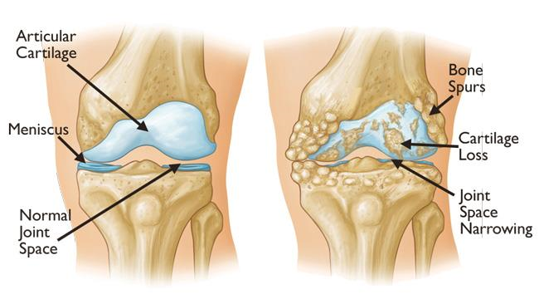

Slide 10
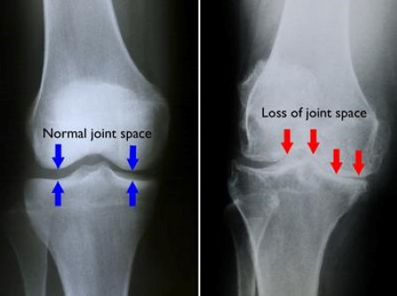

Slide 11
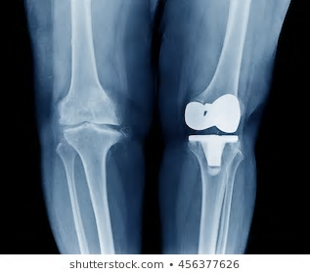

Slide 12
Report on research activities facilitated by Lions Club donations
Donations from the Lions Club have funded the purchase of a Tecan HydoFlex plate washer (pictured previously). This equipment allows the automate washing of tissue culture plates for a wide variety of applications, including many currently performed using the Tecan Infinite M1000 PRO multifunction plate reader that was purchased thanks to a previous donation from the Lions club. Ultimately, these machines improve efficiency and accuracy in many of the assays we run on a daily basis, making much of our lab work more effective and productive.

Slide 13
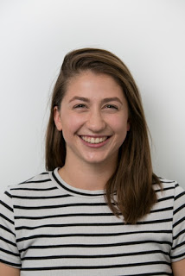
Rachel Mende
Success stories from our lab facilitated by Lions Club Donations
Monash medical students’ research paves the way for improved treatments for lupus
Latest research at Monash University reveals a particular protein found in the blood of lupus patients may be a potential biomarker of kidney disease.
Co-authored by final year Monash medical students Rachel Mende and Emily Lin, both supervised by Dr Tali Lang, the study was published last week in Frontiers in Immunology.
Systemic lupus erythematosus (SLE), or lupus, is an incurable systemic autoimmune illness, which predominantly affects women of child-bearing age.
“This study is the largest to date which examines clinical associations between SLE disease parameters and two particular blood proteins: IL-18 and IL-1β,” said first author Rachel, who undertook the research as a BMedSc(Hons) student at the School of Clinical Sciences at Monash Health (SCS).

Slide 14
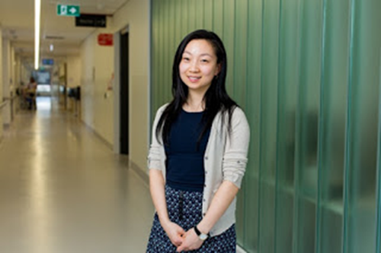
“We measured these two proteins in the blood of lupus patients and found that increased serum IL-18 was associated with the presence of kidney disease and irreversible organ damage while there was no association between serum IL-1β and SLE clinical outcomes.”
Postdoctoral Research Fellow from the Rheumatology Research Group, Dr Fabien Vincent said the data suggests that serum IL-18 and IL-1β have different clinical implications in lupus.
“Future research investigating whether lupus patients with kidney disease may benefit from a drug targeting IL-18 would be of value,” said Dr Vincent, co-lead author on the paper.
Emily Lin

Slide 15
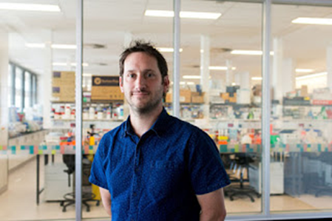
Dr
World-first discovery reveals another piece in the puzzle of how inflammation is controlled
In a world-first, Monash University researchers have discovered a new role that a specific protein plays in the control of inflammation, potentially paving the way for improved treatments for a range of conditions, including gout and arthritis.
Published in NatureCommunications, the research shows how macrophage migration inhibitory factor (MIF)—a protein that effects the behaviour of cells—could specifically control a wide variety of immune and inflammatory responses.
Study author Dr Jim Harris said the discovery shows that MIF plays a very specific role in regulating particular interleukins, a group of proteins expressed by white blood cells.
“We’ve known for some time that MIF is involved in a number of autoimmune and inflammatory diseases, including arthritis, lupus, Crohn’s disease and some cancers,” said Dr Harris from the Rheumatology Research Group, School of Clinical Sciences at Monash Health.
“Yet, despite over 50 years of research, exactly how MIF exerts its many reported effects has been something of a mystery.”
“Our research suggests MIF regulates specific interleukins that are highly inflammatory and are known to contribute to many inflammatory diseases including gout, inflammatory bowel disease, juvenile idiopathic arthritis and some rare cryopyrin-associated autoinflammatory syndromes.”
Dr Harris said this discovery has the potential to not only help us understand how MIF controls inflammation, but also enables us to reliably test potential MIF-targeting therapies, an issue that has previously hampered attempts to develop effective and safe MIF-targeting drugs.
The study also demonstrates the effectiveness of a novel small molecule MIF inhibitor developed by Professor Eric Morand through previous Monash spinoff company Cortical Pty Ltd. The work was a collaborative effort involving researchers from Monash, the Hudson Institute of Medical Research and the University of Melbourne.
Dr Jim Harris

Slide 16
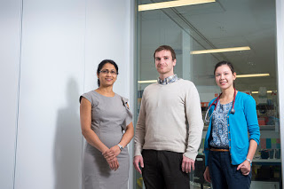
Monash recognised as leader in lupus research
Dr Champa Nataraja, Dr Fabien Vincent,
Dr Kathryn Connelly

