Slide 1
Lions Rheumatism & Arthritis Medical Research Foundation Aus
Notes:
Slide 1
Lions Rheumatism & Arthritis Medical research Foundation Australia
it is estimated that there are between 4 to 6 million people with Arthritis in Australia about 1 in 4 to 5 people. Different types of Arthritis are prevalent and it does not only affect the elderly but also children as well
Two basic types Osteo and Rheumatoid. Both have effects upon those that suffer the disease. There is no known cure, but medication eases the pain. The Research Foundation was started in 1980 as part of district 201V1 to find the causes of arthritis. In 2006 it came under the VLF by a vote from the 6 V districts, the bulk of the funds were transferred to the VLF in 2007.

Slide 2
Notes:
The Lions Rheumatism and Arthritis Medical Research Foundation Australia was established by the Lions Clubs of Elwood in March 1981 as a Charitable Trust, to support the development of Rheumatism and Arthritis Research.
At V conventions during 2006 the LR&MRF came under the umbrella of the Victorian Lions Foundation and transferred funds to the VLF in January 2007.
The Research is for the benefit of the population within the five Lions Club Districts encompassing Victoria and Southern New South Wales.
This is a Lions International District 201V1-4 project and is currently run by elected members from the following Lions Clubs; Northcote, Heidelberg-Warringal and Essendon, for the Victorian Lions Districts.
As you are aware it is now a Category C in the Multiple District 201

Slide 3
History
The Foundation was formed by the Lions Club of Elwood and was originally a project of District 201V1.
Notes:
The first trustees in 1980 were Lion Ian Collis (Elwood), Past District Governor Neil Armstrong, Lions Henry Bell, David Hatfield, Piloo Rustromjee, and Roger Newton. Elwood had two trustees up until about 2000.
Lion Terry Collison joined the Trustees in the early 90s, was Vice Chairman and took over from Neil as Chairman in the middle 90s until 2000.
Main fundraising in the beginning was donations from Clubs in District 201V1. From 1994 to 1997, the Foundation was the main beneficiary for the "Gown of the Year” (run by the fashion industry).
The Foundation funded research at the Monash Medical Centre from the beginning and was funding at $10,000 per year ($2500 each quarter) from interest earned.
Current donations are about $5000 per year.

Slide 4
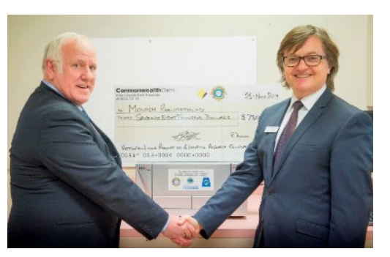
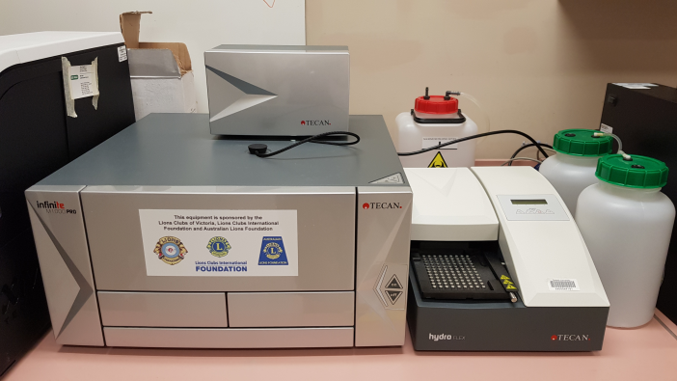
Lions Rheumatism and Arthritis Medical Research Foundation Australia
A Project of the Lions Clubs in Victoria, Australia
A Victorian Lions Club Project
Eric Gittins and Monash Head of Rheumatology Prof Eric Morand with the M1000 Pro multifunction plate reader and
Tecan HydoFlex plate washer
Tecan HydoFlex plate washer
Notes:
The primary role of the Foundation is to create a Capital Fund to support research programmes through liaison with Lions Clubs, Charitable Trusts and Corporations.
One of the latest donation from Lions Clubs of $78000.00 plus funds from Monash was made to purchase a Tecan Microplate Reader. As shown on the slide and also the plate washer purchase for $11000.00 on the right
Donations from the Lions Club funded the purchase of a Tecan HydoFlex plate washer. This equipment allows the automate washing of tissue culture plates for a wide variety of applications, including many currently performed using the Tecan Infinite M1000 PRO
Ultimately, these machines improve efficiency and accuracy in many of the assays that are run on a daily basis, making much of the lab work more effective and productive

Slide 5
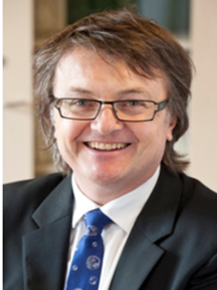
Tecan Analyser and Plate Washer
Notes:
Slide 5
This slide shows how some of the funds have been given, with the help of LCIF and also ALF plus contributions from clubs and Business.
Recently Professor Eric Morand at Monash release a report on trials that have been done with a drug to help with Lupus, another part of the arthritis symptoms, with some very good and positive outcomes.
The R&A foundation also supports a PhD student in this area for $5000 per year for 3 years, inserted is the head of Rheumatology professor Eric Morand

Slide 6
Aims
To maintain a fund so as to support a Research Fellow.
The fund’s target is $2 million.
Current balance in December 2019 is $350k.
Notes:
Slide 6
As the slide states the aims are to raise about $2millions so as to be self supportive of the capital to enable to sponsor a Research Fellow
Funds from the investment should allow for this

Slide 7
About Us
Current Trustees are all elected from Lions Clubs International District 201V1-4 on a rotational basis:
Chairperson: Past District Governor Pauline Harris
Secretary/Treasurer: Past District Governor Eric Gittins
Committee Members: Lion Marie Cavern Lion Winston van Haltren Lion Rodney Hales Lion Selva Selvendra

Slide 8
Professor Eric Morand is a specialist rheumatologist, and Head of the Southern Health/Monash Medical Centre Rheumatology Unit.
Notes:
Eric Morand specialises in the clinical care of complex rheumatic diseases, rheumatoid arthritis, and systemic lupus erythematosus. (SLE)
He is founder of the Monash Lupus Clinic, Australia's largest Lupus-focussed research-grounded clinic for patients with SLE.

Slide 9
Notes:
This article was from the Herald Sun on 20th Dec 2019 updating the latest results of a drug anifrolumab to help reduce the impact of Lupus in all organs and skin

Slide 10
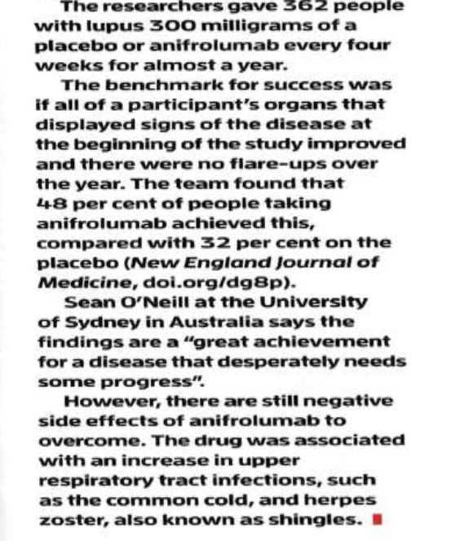
From the New Scientist 4th January 2020
Notes:
Similar to the last slide but comments on side effects which had an increase in upper respiratory tract infection , ie the common cold and the herpes zoster (also known as shingles). Did you know over 70’s get that vacine for shingles free?

Slide 11
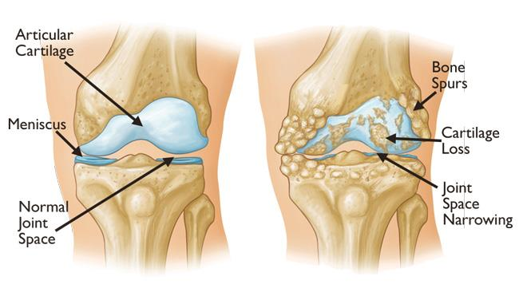
Notes:
What is rheumatoid arthritis?
Rheumatoid arthritis (RA) is an autoimmune disease, in many ways similar to lupus, that causes pain and swelling of the joints. The normal role of your body's immune system is to fight off infections to keep you healthy. In an autoimmune disease, your immune system starts attacking your own healthy tissues. In RA, the immune system targets the lining of the joints, causing inflammation and joint damage. RA usually affects smaller joints, such as the joints in the hands and feet. However larger joints such as the hips and knees can also be affected.

Slide 12
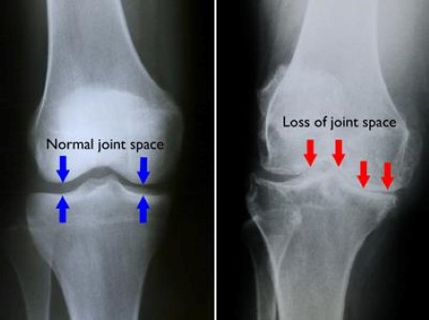
Notes:
Who's at risk?
Despite widely held views, developing rheumatoid arthritis is not a normal part of ageing. It's a condition seen in people of all ages, including children and young people, and people from all backgrounds and lifestyles. The causes of RA are unknown, however it is more common in people who smoke or those with a family history of rheumatoid arthritis.
Recent surveys (National Statistics and also University of Queensland) report that 1 in 5 or 6 people have a form of Arthritis, that equals 4 to 5million Australians.

Slide 13
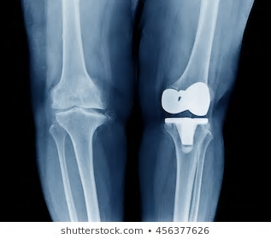
Notes:
What is Osteo-arthritis?
Sometimes called degenerative joint disease or degenerative arthritis, osteoarthritis (OA) is the most common chronic condition of the joints, affecting approximately up to 5 million Australians. OA can affect any joint, but it occurs most often in knees, hips, lower back and neck, small joints of the fingers and the bases of the thumb and big toe.
In normal joints, a firm, rubbery material called cartilage covers the end of each bone. Cartilage provides a smooth, gliding surface for joint motion and acts as a cushion between the bones. In OA, the cartilage breaks down, causing pain, swelling and problems moving the joint. As OA worsens over time, bones may break down and develop growths called spurs. Bits of bone or cartilage may chip off and float around in the joint. In the body, an inflammatory process occurs and cytokines (proteins) and enzymes develop that further damage the cartilage. In the final stages of OA, the cartilage wears away and bone rubs against bone leading to joint damage and more pain. The slide shows a good knee joint and one that has had a replacement
Who is Affected?
Although OA occurs in people of all ages, osteoarthritis is most common in people older than 65. Common risk factors include increasing age, obesity, previous joint injury, overuse of the joint, weak thigh muscles, and genes.
One in two adults will develop symptoms of knee OA during their lives.
One in four adults will development symptoms of hip OA by age 85.
One in 12 people 60 years or older have hand OA. https://www.arthritis.org (US)
Osteo is what is described above with degeneration of the joint. There is no cure for this, but treatment can help. Tablets, creams etc. and replacement.
How can you stop the arthritis from starting?
The easiest way is to have healthy eating and regular exercise, though this is good health there are no guarantees.

Slide 14
Report on research activities facilitated by Lions Club donations
Notes:
Donations from the Lions Club have funded the purchase of a Tecan HydoFlex plate washer (pictured previously). This equipment allows the automate washing of tissue culture plates for a wide variety of applications, including many currently performed using the Tecan Infinite M1000 PRO multifunction plate reader that was purchased thanks to a previous donation from the Lions club.

Slide 15
What does MIF do?
We discovered that MIF regulates another cytokine – IL-1
IL-1 has a clear, well described role to play in inflammation and autoimmunity
This action of MIF was independent of its role as a cytokine…
A new mode of action for MIF?
(this has sparked a large new study looking for other new functions of MIF)
(thanks)
Notes:
MIF or Macrophage Migration inhibitory factor

Slide 16
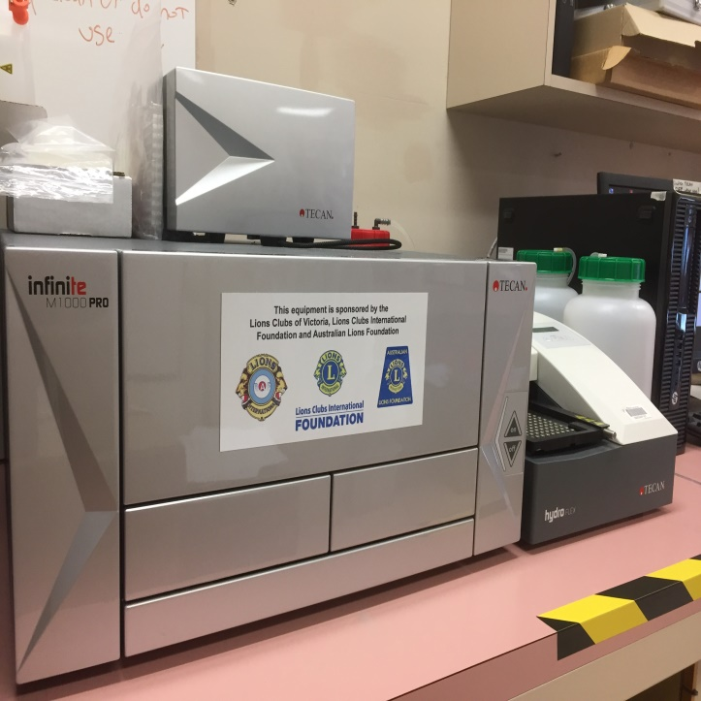
Our Fundamental Research

Slide 17
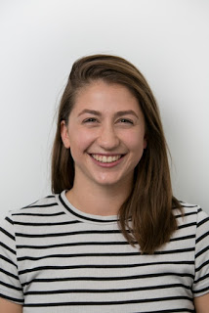
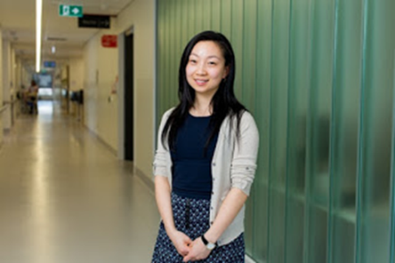
Success stories from our lab facilitated by Lions Club Donations
Monash medical students’ research paves the way for improved treatments for lupus
Co-authored by final year Monash medical students Rachel Mende and Emiy Lin, both supervised by Dr Tali Lang, the study was published last week in Frontiers in Immunology.
Notes:
Co-authored by final year Monash medical students Rachel Mende and Emiy Lin, both supervised by Dr Tali Lang, the study was published last week in Frontiers in Immunology.
Systemic lupus erythematosus (SLE), or lupus, is an incurable systemic autoimmune illness, which predominantly affects women of child-bearing age.
“This study is the largest to date which examines clinical associations between SLE disease parameters and two particular blood proteins: IL-18 and IL-1β,” said first author Rachel, who undertook the research as a BMedSc(Hons) student at the School of Clinical Sciences at Monash Health (SCS).

Slide 18
Postdoctoral Research Fellow from the Rheumatology Research Group, Dr Fabien Vincent said the data suggests that serum IL-18 and IL-1β have different clinical implications in lupus.
“Future research investigating whether lupus patients with kidney disease may benefit from a drug targeting IL-18 would be of value,” said Dr Vincent, co-lead author on the paper.
Emily Lin
Notes:
“We measured these two proteins in the blood of lupus patients and found that increased serum IL-18 was associated with the presence of kidney disease and irreversible organ damage while there was no association between serum IL-1β and SLE clinical outcomes.”
Postdoctoral Research Fellow from the Rheumatology Research Group, Dr Fabien Vincent said the data suggests that serum IL-18 and IL-1β have different clinical implications in lupus.
“Future research investigating whether lupus patients with kidney disease may benefit from a drug targeting IL-18

Slide 19
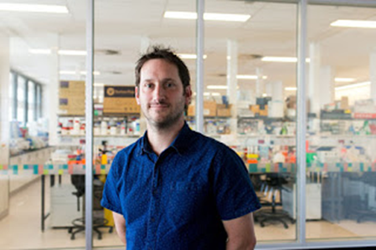
Dr
World-first discovery reveals another piece in the puzzle of how inflammation is controlled
In a world-first, Monash University researchers have discovered a new role that a specific protein plays in the control of inflammation, potentially paving the way for improved treatments for a range of conditions, including gout and arthritis.
Published in NatureCommunications, the research shows how macrophage migration inhibitory factor (MIF)—a protein that effects the behaviour of cells—could specifically control a wide variety of immune and inflammatory responses.
Study author Dr Jim Harris said the discovery shows that MIF plays a very specific role in regulating particular interleukins, a group of proteins expressed by white blood cells.
“We’ve known for some time that MIF is involved in a number of autoimmune and inflammatory diseases, including arthritis, lupus, Crohn’s disease and some cancers,” said Dr Harris from the Rheumatology Research Group, School of Clinical Sciences at Monash Health.
“Yet, despite over 50 years of research, exactly how MIF exerts its many reported effects has been something of a mystery.”
“Our research suggests MIF regulates specific interleukins that are highly inflammatory and are known to contribute to many inflammatory diseases including gout, inflammatory bowel disease, juvenile idiopathic arthritis and some rare cryopyrin-associated autoinflammatory syndromes.”
Dr Harris said this discovery has the potential to not only help us understand how MIF controls inflammation, but also enables us to reliably test potential MIF-targeting therapies, an issue that has previously hampered attempts to develop effective and safe MIF-targeting drugs.
The study also demonstrates the effectiveness of a novel small molecule MIF inhibitor developed by Professor Eric Morand through previous Monash spinoff company Cortical Pty Ltd. The work was a collaborative effort involving researchers from Monash, the Hudson Institute of Medical Research and the University of Melbourne.
Dr Jim Harris

Slide 20
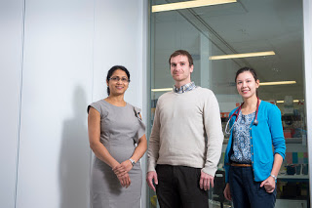
Monash recognised as leader in lupus research
Dr Champa Nataraja, Dr Fabien Vincent, Dr Kathryn Connelly

Slide 21
Rheumatology Group – Meet the Researchers
Jacqueline
Max
Fabien
Scruffbag
Hieu
Dinith
Hasnat
Megan
Wendy
Mehnaz
Eric
Sarah
Dorothy
Wendy

Slide 22
Our Fundamental Research
Biomarkers of disease
Identifying proteins/molecules that correlate with or predict severity of disease
These include inflammatory markers and cytokines
Allows clinicians to better diagnose patients and tailor treatment (personalised medicine)
We are currently working with Monash IT and companies to develop ways to measure and analyse large numbers of biomarkers at the same time
Fabien
Talented postdoc
Hieu
IT/bioinformatics
genius
Rachel
Honours student
Emily
Honours student
Tali
Former
postdoc
Scruffbag
Grinning idiot

Slide 23
Our Fundamental Research
Biomarkers of disease
Identifying proteins/molecules that correlate with or predict severity of disease
These include inflammatory markers and cytokines
Allows clinicians to better diagnose patients and tailor treatment (personalised medicine)
We are currently working with Monash IT and companies to develop ways to measure and analyse large numbers of biomarkers at the same time
Fabien
Talented postdoc
Hieu
IT/bioinformatics
genius
Rachel
Honours student
Emily
Honours student
Tali
Former
postdoc
Scruffbag
Jim Harris
Grinning idiot

